Slide 1
Static Electricity
Subtitle

Slide 2
Electrostatics
Attractive and repulsive forces that are the foundation of our existence
Examples:
Clothes in the dryer stick together without a dryer sheet
Cat’s fur stands on end after you pet them
Bolt’s of lightning during a storm
A shock from a door knob after walking on carpet

Slide 3
History
400 BC
Greek philosophers proposed matter is made of invisible building blocks called “Atomos” Latin for invisible blocks
Late 1600
Robert Boyle studied gaseous substances and promoted the idea of different types of substance
Elements

Slide 4
History
Early 1800’s
John Dalton conducted experiments to show different elements can be combined in different fixed ratios of masses to form compounds
Late 1800’s
J.J.Johnson used cathode ray experiments which led to the discovery of electrons and the idea that atoms are structurally INDIVISIBLE

Slide 5
History
~1900
Ernest Rutherford conducted a gold foil experiment leading to the Nuclear Atomic model
1913
Neil Bohr improved on Rutherfords model including the electron

Slide 6
Quantum Mechanics
Atoms are composed subatomic particles
Electron shells are regions
Outer shells have a higher energy level
Electrons can move between shells
Electrons can be removed from an atom with sufficient energy

Slide 7
Conclusion on Static Electricity
All materials are composed of atoms
Nucleus contains protons and neutrons

Slide 8
Neutral vs Charged
Neutral atoms are elements
Charged atoms are ions (charge imbalance)
This occurs began electrons can migrate
Example: Electrons are likely moving from your computer monitor and adhering to your clothes right now
When do electrons move?
When they are motivated

Slide 9
Charges
Are measurable quantities
Expressed in Coulombs (C) = -1 C is equal to 6.25 X 10¹⁸ electrons
Both electrons and protons have the magnitude of 1.6 X 10⁻¹⁹ C

Slide 10
Charge Interactions
Electrical Forces
Non contact force
Attract and Repel
Positively or Negatively charged
Use the same Laws and Principles as other forces (ex. Newtons Laws)

Slide 11
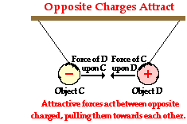
Newton’s 3rd Law
Interaction between charge C and charge D
Forces are attractive

Slide 12
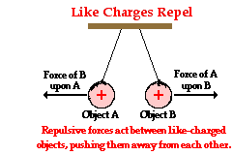
Newton’s 3rd Law
Interaction between charge A and charge B
Forces are repel

Slide 13
Forces between a charged and a neutral particle
Protons attract neutral
Electrons attract neutral

Slide 14
Repulsion Vs. Attraction
Repelling must be like charges (-/- or +/+)
Attractions can be multiple scenarios (+/0, -/0, or +/-)
Both need addition testing to determine the actual charge)

Slide 15
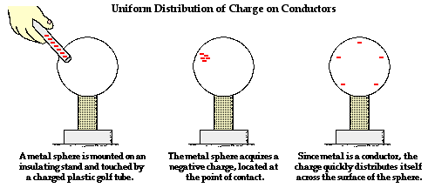
Conductors
Allow electrons to move freely from one particle to another
Charges can be transferred
Transported electrons will ALWAYS distribute the charge until the overall repulsive forces between electrons are minimized
If a charge object is touch by another object, charges can be transferred to the new object

Slide 16
Insulators
Impede the free flowing electrons from atom to atom or molecule to molecule
If a charge is transferred to an insulator
The charge will stay at that location
There is no distribution

Slide 17
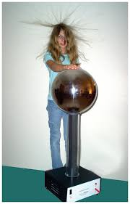
Conductivity as a Continuum
Human Body and a Van De Graff Generator

Slide 18
Predicting Charge Movement
Negative Charge to an object
If an electron is added…there are excess negative charges at that location
Overall a repulsive response, even though some electrons will be attracted to the protons
In a conductor this is minimized by distribution
Positive Charge to an object
If an electron is removed
Positive charges are localized and can not move

Slide 19
Electrons are Curious Particles
Some electrons will feel an attraction from a distance and are free moving
Protons are bound and can not move

Slide 20
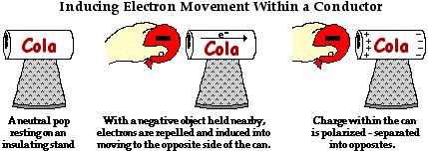
Polarization
The process of separating opposite charges within an object
Induction of movement by an electron in a conductor

Slide 21
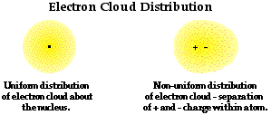
Polarization
The process of separating opposite charges within an object
Induction of movement by an electron in an insulator

Slide 22
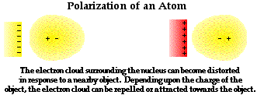
Polarization
The process of separating opposite charges within an object
Induction of movement by a charge and a neutral object

Slide 23
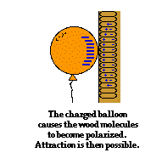
Polarization Example
Negatively charged balloon and Neutrally charged wood wall

Slide 24
Polarization Recap
Polarization is not charging
Polarization is charge redistribution
Yes….. there is charge separation
No…… there is NO charge imbalance
Protons and Electrons are equal
The object is Neutral

